Slide 1
SBA To Provide Economic Injury Disaster Loans
For Coronavirus Related Economic Disruptions

Slide 2
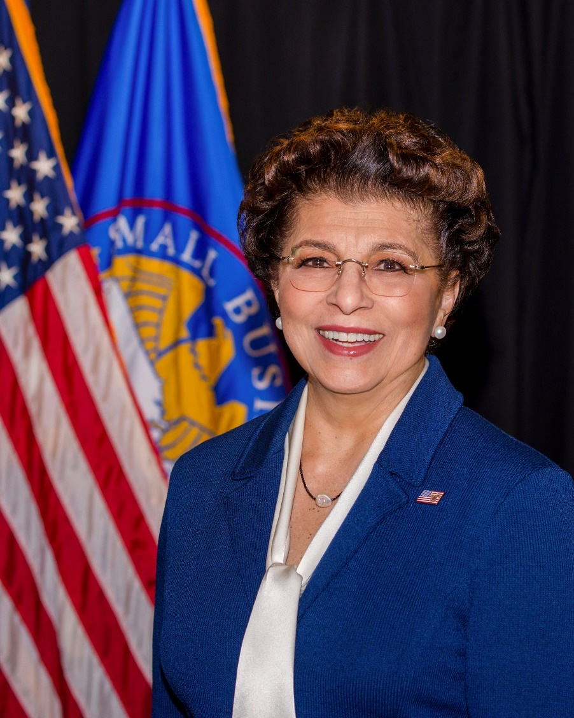
SBA’s Disaster Declaration Makes Loans Available Due to the Coronavirus (COVID-19)
The U.S. Small Business Administration (SBA) is offering designated states and territories low-interest federal disaster loans for working capital to small businesses suffering substantial economic injury as a result of the Coronavirus (COVID-19).
Upon a request received from a state’s or territory’s Governor, SBA will issue under its own authority, as provide by the Coronavirus Preparedness and Response Supplement Appropriations Act that was recently signed by the President, an Economic Injury Disaster Loan declaration.
Administrator Jovita Carranza

Slide 3
SBA’s Economic Injury Disaster Loan Basics
What businesses are eligible to apply?
SBA’s Economic Injury Disaster Loans (or working capital loans) are available to small businesses, small agricultural cooperatives, small aquaculture businesses and most private non-profit organizations
This includes:
Businesses directly affected by the disaster
Businesses that offer services directly related to the businesses in the declaration
Other businesses indirectly related to the industry that are likely to be harmed by losses in their community
(Example: Manufacturer of widgets may be eligible as well as the wholesaler and retailer of the product.
3

Slide 4


SBA’s Economic Injury Disaster Loan Basics
What is the criteria for a loan approval?
Credit History-Applicants must have a credit history acceptable to SBA.
Repayment –SBA must determine that the applicant business has the ability to repay the SBA loan.
Eligibility- The applicant business must be physically located in a declared county and suffered working capital losses due to the declared disaster, not due to a downturn in the economy or other reasons.

Slide 5
SBA’s Economic Injury Disaster Loan Terms
How much can I borrow?
Eligible entities may qualify for loans up to $2 million.
The interest rates for this disaster are 3.75 percent for small businesses and
2.75 percent for nonprofit organizations with terms up to 30 years.
Eligibility for these working capital loans are based on the size (must be a small business) and type of business and its financial resources.
How can I use the loan funds?
These working capital loans may be used to pay fixed debts, payroll, accounts payable, and other bills that could have been paid had the disaster not occurred. The loans are not intended to replace lost sales or profits or for expansion.

Slide 6

Economic Injury Disaster Loan Terms
What are the collateral requirements?
  Economic Injury Disaster Loans over $25,000 require collateral.
  SBA takes real estate as collateral when it is available.
  SBA will not decline a loan for lack of collateral,
  but requires borrowers to pledge what is available.
6

Slide 7

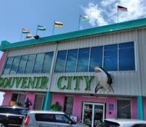

SBA’s Economic Injury Disaster Loan Basics
What kinds of small businesses can apply?
Examples of eligible industries include but are not limited to the following: hotels, recreational facilities, charter boats, manufacturers, sports vendors, owners of rental property, restaurants, retailers, souvenir shops, travel agencies, and wholesalers.
What other criteria is involved?
The applicant business must have a physical presence in the declared disaster area. An applicant’s economic presence alone in a declared area does not meet this requirement. The physical presence must be tangible and significant. Merely having a P.O. Box in the disaster area would not qualify as a physical presence.
7

Slide 8
SBA’s Working Capital Loans are Different from Other SBA Loans
SBA’s Economic Injury Disaster Loan (EIDLs) funds come directly from the U.S. Treasury.
Applicants do not go through a bank to apply. Instead apply directly to SBA’s Disaster Assistance Program at: DisasterLoan.sba.gov
There is no cost to apply.
There is no obligation to take the loan if offered.
The maximum unsecured loan amount is $25,000.
Applicants can have an existing SBA Disaster Loan and still qualify for an EIDL for this disaster, but the loans cannot be consolidated.

Slide 9
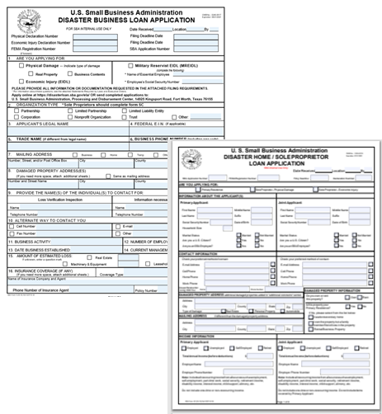
Basic Filing Requirements
Completed SBA loan application (SBA Form 5 or
SBA Form 5C for sole proprietorships.)
Tax Information Authorization (IRS Form 4506T)
for the applicant, principals and affiliates.
Complete copies of the most recent Federal Income Tax Return.
Schedule of Liabilities (SBA Form 2202).
Personal Financial Statement (SBA Form 413).
Other Information may also be requested.
*Although a paper application and forms are acceptable, filing electronically is easier, faster and more accurate.
9

Slide 10
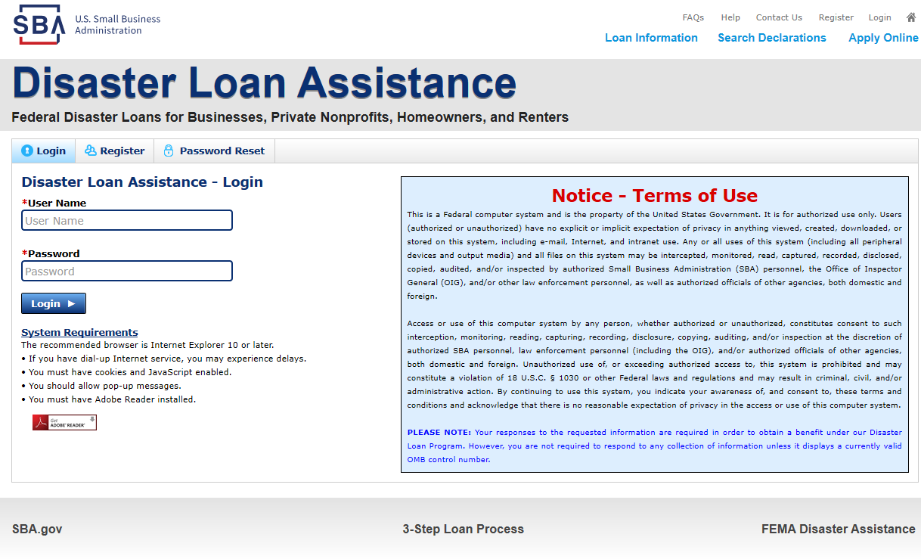
Additional Filing Requirements
Other information that may be requested:
Complete copy, including all schedules, of the most recent Federal income tax return for principals, general partners or managing member, and affiliates (see filing requirements for more information).
If the most recent Federal income tax return has not been filed, a year-end profit-and-loss statement and balance sheet for that tax year .
A current year-to-date profit-and-loss statement .
Additional Filing Requirements (SBA Form 1368) providing monthly sales figures. (This is especially important for Economic Injury Disaster Loans.)
10

Slide 11
Private Non-Profit Organizations
Examples of Non-Profit Organizations: Nursing homes, food kitchens, museums, educational facilities, senior citizen centers, daycare centers, playhouses, community centers, shelters, rescue organizations, associations, etc.
An eligible private non-profit organization is a non-governmental agency or entity that currently has:
(1) An effective ruling letter from the U.S. Internal Revenue Service, granting tax exemption under sections 501(c), (d), or (e) of the Internal Revenue Code of 1954, or
(2) Satisfactory evidence from the State that the non-revenue producing organization or entity is a non-profit one organized or doing business under State law.
11

Slide 12
Ineligible Entities
What are some of the businesses that are ineligible for an Economic Injury Disaster Loan?
Agricultural Enterprises -If the primary activity of the business (including its affiliates) is as defined in Section 18(b)(1) of the Small Business Act, neither the business nor its affiliates are eligible for EIDL assistance.
Religious Organizations
Charitable Organizations, businesses considered hobbies, government-owned concerns.
Gambling Concerns (Ex: Concerns that derive more that 1/3 of their annual gross revenue from legal gambling activities)
Casinos & Racetracks (Ex: Businesses whose purpose for being is gambling (e.g., casinos, racetracks, poker parlors, etc.) are not eligible for EIDL assistance regardless of 1/3 criteria above.
Real estate developers-establishments primarily engaged in subdividing real property into lots and developing it for resale on their own account.
12

Slide 13
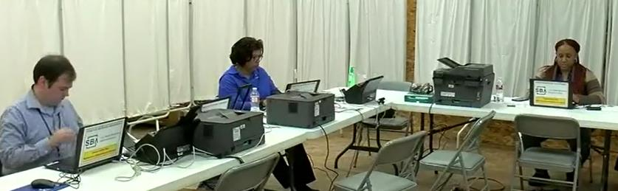
How to Apply
SBA’s Customer Service Representatives are ready to serve.
Applicants may apply online using the Electronic Loan Application (ELA) via SBA’s secure website at https://disasterloan.sba.gov/ela.
Paper loan applications can be downloaded from www.sba.gov/disaster. Completed applications should be mailed to: U.S. Small Business Administration, Processing and Disbursement Center, 14925 Kingsport Road, Fort Worth, TX 76155.
Disaster loan information and application forms may also be obtained by calling the SBA’s Customer Service Center at 800-659-2955
(800-877-8339 for the deaf and hard-of-hearing) or by sending an email to disastercustomerservice@sba.gov.

Slide 14
Submit Your Application
As Soon As Possible
Recheck the filing requirements to ensure that all the needed information is submitted.
The biggest reason for delays in processing is due to missing information. Make sure to complete all filing requirements before submitting the application and forms.
If more funds are needed, applicants can submit supporting documents and a request for an increase. If less funds are needed, applicants can request a reduction in the loan amount.
If the loan request is denied, the applicant will be given up to six months in which to provide new information and submit a written request for reconsideration.

Slide 15
Assistance From SBA Partners
Free assistance with reconstructing financial records, preparing financial statements and submitting the loan application is available from any of SBA’s partners: Small Business Development Centers (SBDCs), SCORE, Women’s Business Centers (WBC), and Veteran’s Business Outreach Centers and local Chambers of Commerce.
For the nearest office, visit: https://www.sba.gov/local-assistance

Slide 16
SBA Disaster Loan Assistance
ORGANIZATION | LOCATIONS | PHONE | EMAIL/WEBSITE
SBA | Milwaukee Madison | 414-297-3941 608-441-5263 | Wisconsin@sba.gov
SBDC Network | 13 offices statewide | Answerline 800-940-7232 | Find local contacts at https://business.wisconsin.edu/about/covid-19/
WI Women’s Business Initiative Corp. | Milwaukee, Madison, Racine, Kenosha, Appleton, Green Bay, La Crosse |  | info@wwbic.com www.wwbic.com
Western WI Women’s Business Center | Independence, Eau Claire |  | www.successfulbusiness.org
SCORE | Milwaukee Madison Marshfield | 414-297-3942 | Score.28@scorevolunteer.org Counseling.28@scorevolunteer.org madison.Score@scorevolunteer.org ch.admin0535@scorevolunteer.org
Veterans Business Outreach Center | Statewide | 608-204-8909 | ltaylor@wwbic.com
All locations are working remotely. Contact by phone or email.

Slide 17

Any Questions?
More information concerning
SBA and its programs
visit our website at:
www.sba.gov/disaster

